Slide 1
CSE308:COMPUTING PRACTICUM-IV
Unit 4: Controlling Access to Files with ACLs
Interpreting File ACLs
Securing Files with ACLs
Outcome: Apply ACLs on files and enhance system security using SELinux

Slide 2
Users and Groups in Linux
Create users:->
useradd [options] username
useradd username
sudo useradd username (if home directory is not created then go for sudo useradd –m username)
sudo useradd –m –d /abc/username username (for creating specific home directory)
sudo useradd –u 1000 username (create a user with userid)
id –u username
sudo passwd username

Slide 3
Linux File Ownership
Chmod : 1-ownership 2-group permission 3- others user permission
-rwxrw-r--
drwxrw-r--
Chmod a+x filename
Chmod u+x filename
Chmod u+r filename
Chmod g+r filename
4-read
2-write
1-execute

Slide 4
Linux File Ownership
Chown : to change the ownership
Open two terminals with different users
Create a file in first user and check for its permissions
Go in second terminal and open the file and check its permissions
Try to make changes in the file by using vi editor(As you have only read permissions)
Then one way is to change the permissions of the file but it is going to be applicable for all users.
Chown –c user2 filename (Need root permissions)
Check for its permissions its owner is changed
Go to second terminal and can check the file permissions
Now second user can change or manipulate the file

Slide 5
Linux File Ownership
Chgrp: to change group permission
Sudo chgrp –c user2 filename

Slide 6
Umask
To check for default permissions on directories and file
Delete the umask from 777 in case of directories
Delete the umask 666 in case of files
System never gives execute permission by default
We can change the umask like umask 0044
Context for the same is present in /etc/bashrc or /etc/profile

Slide 7
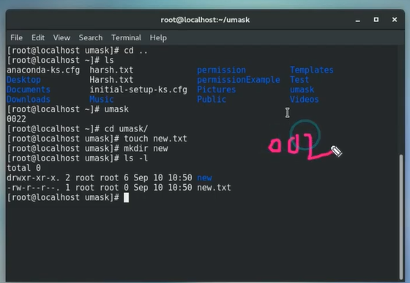
Umask

Slide 8
Umask
Help Ramesh to create a umask for files to get read and write permission and directories to get read,write and execute permissions.
Umask 0

Slide 9


Slide 10
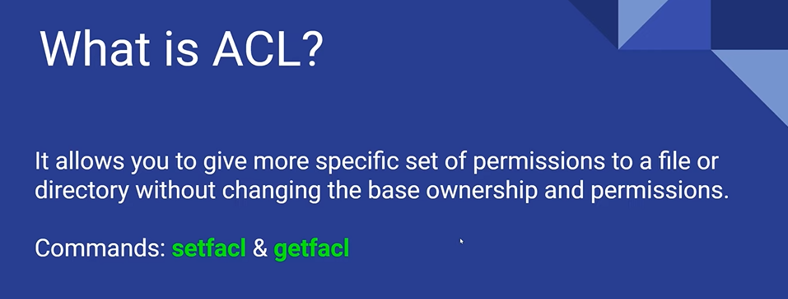

Slide 11
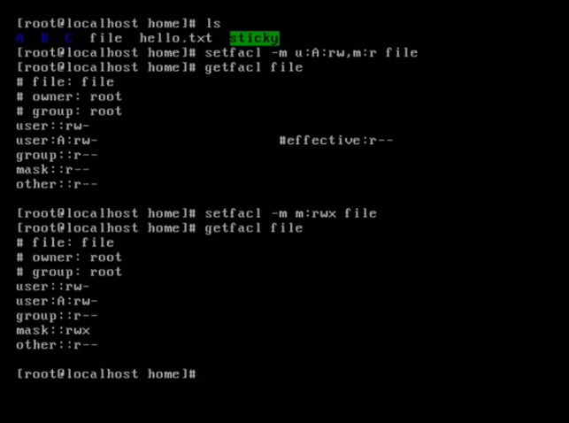
`

Slide 12
Access Control List (ACL)
As a System Admin, our first priority will be to protect and secure data from unauthorized access.
The ACLs allow us to define permissions for specific users and groups.
ACLs are configured and treated the same way on both files and directories.
We cannot set up different permission sets for different users on same directory or file. Thus, Access Control Lists (ACLs) were implemented.

Slide 13
Access Control List (ACL)
Use of ACL :
Think of a scenario in which a particular user is not a member of group created by you but still you want to give some read or write access, how can you do it without making user a member of group, here comes in picture Access Control Lists, ACL helps us to do this trick.
Basically, ACLs are used to make a flexible permission mechanism in Linux.
From Linux man pages, ACLs are used to define more fine-grained discretionary access rights for files and directories.

Slide 14
Access Control List (ACL)
ACLs are categorized into two groups based on their types, and are referred to as access ACLs and default ACLs.
Access ACLs are set on individual files and directories
Default ACLs can only be applied at the directory level.

Slide 15
ACL Management Commands
ACL support is loaded on the system at the time of OS installation via the acl software package.
This package includes two management commands— getfacl, and setfacl
Command Description
getfacl ---Displays ACL settings for a file or directory.
setfacl ---Sets, modifies, substitutes, and deletes ACL settings on a file or directory.

Slide 16
Access Control List (ACL)
setfacl and getfacl are used for setting up ACL and showing ACL respectively.
For example :
getfacl test/file.txt
Output:
# file: test/file.txt
# owner: navjot
# group: navjot
user::rw- group::rw- other::r-- a

Slide 17
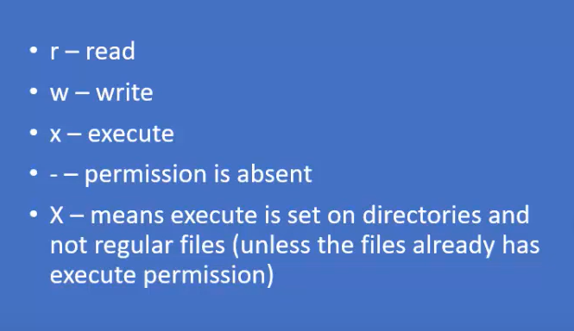
Access Control List (ACL)

Slide 18
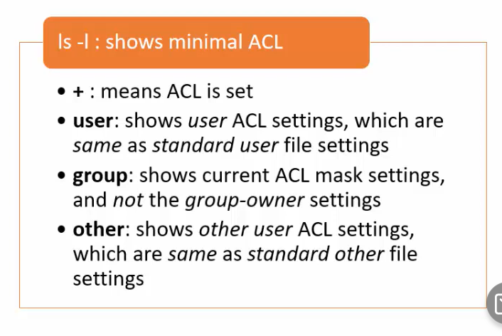
Access Control List (ACL)

Slide 19
Which of the following is used to assign permissions on a file or directory:
getfacl
setfacl

Slide 20
getfacl: example
Create an empty file file1 in /root and then displays the ACLs on it:
# pwd
/root
# touch file1
# getfacl file1
# file: file1
# owner: root
# group: root
user::rw
group::r--
other::r--
The output shows the names of the file, the owner, and the owning group as comments and then it displays the present permissions placed on the file: read and write for the owner and read-only for everyone else.

Slide 21
Which of the following displays ACL on a file or directory
getfacl
setfacl
Both
None

Slide 22
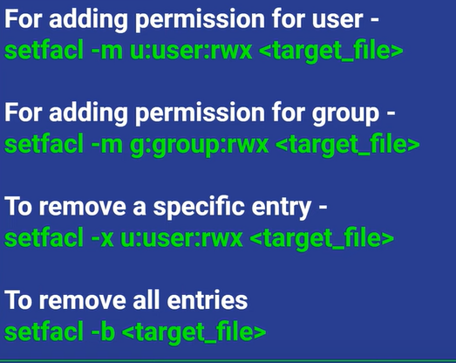

setfacl

Slide 23
setfacl
To set the default ACLs for a specific file or directory, use the ‘setfacl‘ command.
setfacl –m <for whom you need to set permissions u/g/o> : <name of user /group)> : <permissions> <file/directory name>
setfacl -m u:user1:rwx /LPU

Slide 24
setfacl Command Options
The setfacl command provides several switches to use depending on what we want to achieve.
Switch Description
-d Applies to the default ACLs.
-k Removes all default ACL settings.
-m Manage, sets or modifies ACL settings.
-R Applies recursively to all files and sub-directories.
-x Removes an ACL setting.

Slide 25
setfacl Command Options
List of commands for setting up ACL :
1) To add permission for user
setfacl -m "u:user:permissions" /path/to/file
For example : setfacl -m u:navjot:rwx test/file.txt
2) To add permissions for a group
setfacl -m "g:group:permissions" /path/to/file

Slide 26
setfacl Command Options
3) To allow all files or directories to inherit ACL entries from the directory it is within
setfacl -dm "entry" /path/to/dir
Example : setfacl -m u:navjot:r-x test/file.txt
4) To remove a specific entry
setfacl -x "entry" /path/to/file
5) To remove all entries
setfacl -b path/to/file

Slide 27
Remove ACLs
For removing ACL from any file/directory, we use x and b options as shown:
# setfacl -x ACL file/directory # remove only specified ACL from file/directory.
# setfacl -b file/directory #removing all ACL from file/direcoty

Slide 28
The Role of the mask Value
The value of mask determines the maximum allowable permissions placed for a specific user or group on a file or directory.
If it is set to rw, for instance, no specific user or group will exceed those permissions.
Each time ACLs are modified for a file or directory, the mask is recalculated automatically and applied unless we supply our own desired mask value with the command.

Slide 29
# setfacl –m u:user1:rw file1
# getfacl –c file1 // instruct the command not to display the header information.
user::rw-
user:user1:rw- #effective:r--
group::r--
mask::r--
other::--

Slide 30
Access Control List (ACL)
setfacl –m m:rw file1
# getfacl –c file1
user::rw-
user:user1:rw-
group::r--
mask::rw-
other::r--
The actual permissions for user1 are now promoted to include the write bit to reflect the new higher mask value.

Slide 31
Set an ACL and mask value
Set an ACL on a file/dir by using the setfacl command.
$ setfacl -m mask:perms, acl_entry_list dirname

Slide 32
Examples- Setting an ACL
Set the owner permissions to read/write, group permissions to read only, and other permissions to none on the ch1 directory. In addition, the user “user1” is given read/write permissions on “ch1” and the ACL mask permissions are set to read/write, which means no user or group can have execute permissions.

Slide 33
Examples- Setting an ACL
Set the owner permissions to read/write, group permissions to read only, and other permissions to none on the ch1 directory. In addition, the user “user1” is given read/write permissions on “ch1” and the ACL mask permissions are set to read/write, which means no user or group can have execute permissions.
$ setfacl –m m:rw--,u:user1:rw- /ch1

Slide 34
Examples- Setting an ACL
Set the file owner permissions to read/write/execute, file group permissions to read only, other permissions to none, and the ACL mask permissions to read on the “/ch2” directory. In addition, the user “user1” is given read/write permissions; however, due to the ACL mask, the effective permissions for “user1” are read only.

Slide 35
Setting an Default ACL
A directory can have default ACLs set on it that are automatically inherited by all new files and new subdirectories. There can be default ACL permissions set for each of the standard ACL settings, including a default mask.
A directory still requires standard ACLs for access control because default ACLs do not implement access control for the directory; they only provide ACL permission inheritance support.

Slide 36
Setting an Default ACL
An example:
setfacl -m d:u:username:rx directory
The setfacl command for adding a default ACL for each of the ACL types is exactly the same as for standard ACLs, but prefaced with d: Alternatively, use the -d option on the command line.

Slide 37
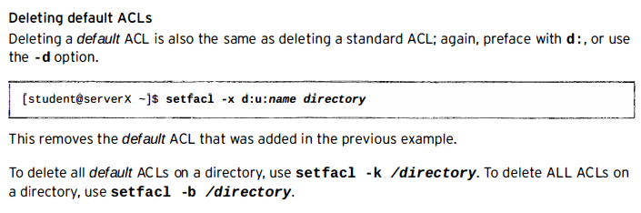
Delete an Default ACL

Slide 38
Delete ACL Entries From a file/dir
Delete ACL entries from a file by using the setfacl command.
$ setfacl -d acl_entry_list /Dirname ...

Slide 39
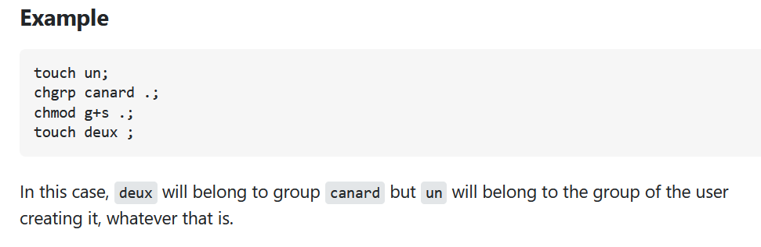
Task-1
The cases directory and its contents should belong to the managers group.
New files added to the cases directory should automatically belong to the managers group.
The user and group owners for the existing files should have read and write permission,
and other users should have no permission at all.

Slide 40
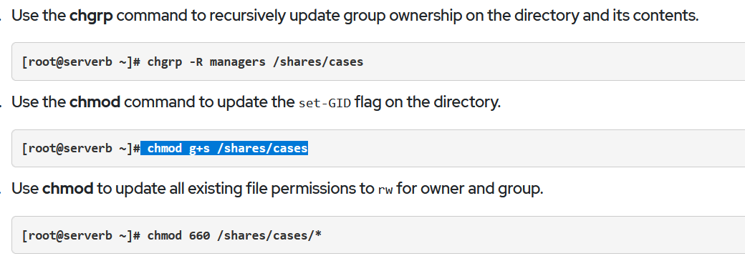
Solution

Slide 41
Task-2
Add ACL entries to the cases directory (and its contents) that allow members of the contractors
group to have read/write access on the files and execute permission on the directory.
Restrict the contractor3 user to read access on the files and execute permission on the directory.

Slide 42
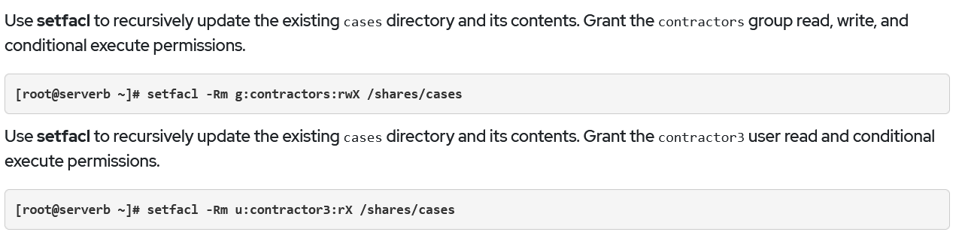
Solution

Slide 43
Task-3
Add ACL entries that ensure any new files or directories in the cases directory have the correct permissions applied for all authorized users and groups.

Slide 44
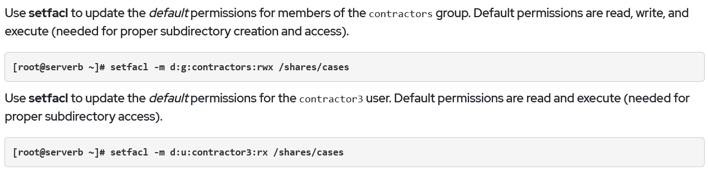
Solution

